Slide 1
PDS Case Management Training

Slide 2
We Will Discuss:
Difference Between Traditional & PDS
Role of a PDS Case Manager
Person-Centered PDS Services
PDS Documentation Requirements
PDS Employment Requirements

Slide 3
Participants may choose to transition to/from traditional waiver services at any time.
TRADITIONAL OPTION
Participant selects CM & DSP agency.
Services provided by DSP agency employees.
PDS OPTION
Participant selects PDS CM agency.
Participant and Rep. hires employees to provide services.
DSP staff works for provider agency.
DSP agency handles employer responsibilities & payroll.
Employee works for the participant.
Participant and Rep. handle employer responsibilities & FMS handles payroll.
B
L
E
N
D
E
D
+
=

Slide 4
PDS Model
Case Management Services
Financial Management Services

Slide 5
Case Manager Activities
Assessing the Participant’s:
Needs
Services
Outcomes
Available Resources
Overall Satisfaction with Waiver Services

Slide 6
RESPONSIBILITIES UNIQUE TO PDS CASE MANAGERS
Facilitate Self-Assessment of Participant’s Support Needs
Assist with Selection of FMA and Coordinate Services
Enable Participants to Execute Employer Authority by Arranging for Supports
Monitor Participant's Employer Authority for Risks, Challenges and Outcomes

Slide 7
FACILITATE SELF-ASSESSMENT
PDS Employer Responsibilities Review → Tool
Optional but Useful for Determining Needed Supports
Outlines Tasks & Activities to be Performed
Case Managers can Use the Tool to Make Sure Support Needs are Met
7

Slide 8
NECESSARY PDS SUPPORTS
Things to Consider:
Recruiting
Interviewing
Background Checks
Screening Employees
Hiring Employees
Training Employees
Rules for Employees
Work Schedules
Timesheets and Approvals
Feedback to the Employee
Firing Employees
Emergency Backup Plan
Paying for Additional Expenses

Slide 9
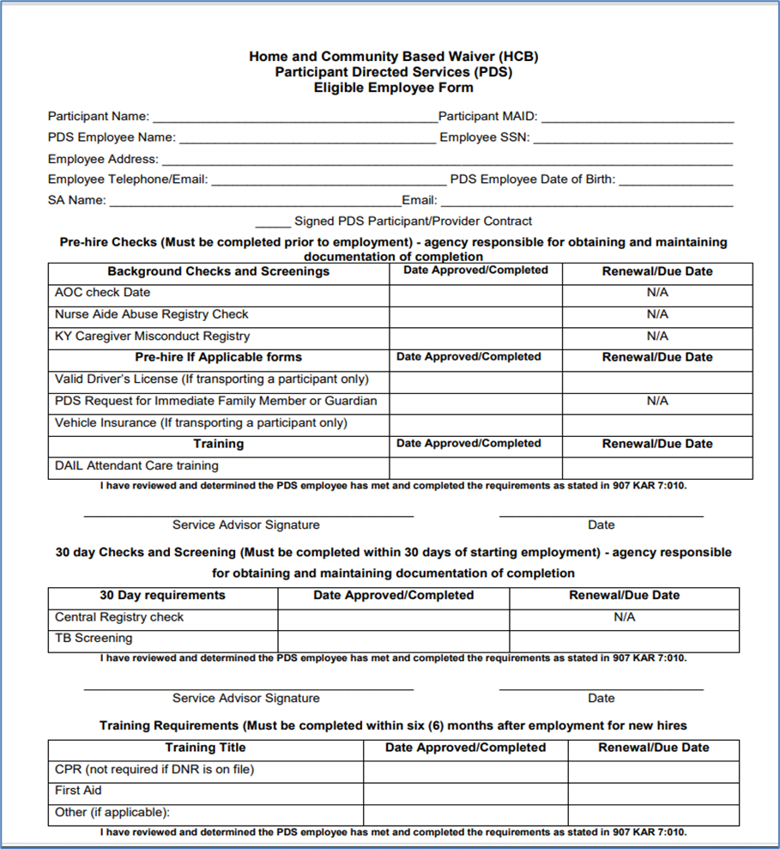
Support of On-Going Financial Management Coordination

Slide 10
MONITORING PARTICIPANT’S EXECUTION OF EMPLOYER AUTHORITY
IDENTIFIED RISKS
CHALLENGES
OUTCOMES

Slide 11
PERSON-CENTERED SERVICES
SECTION II

Slide 12
Person-Centered Service Plans (PCSP)
Review Assessment Tool
Contact Participant for Convenient Date & Time to Meet
Coordinate Participation from any Traditional Provider for Blended Plans
Schedule the PCSP Team Meeting
Ask Participant if they have Identified Potential PDS Employees & Assist with Hiring Process
Create Emergency Back-up Plan

Slide 13
Pds cONTACT REQUIREMENTS
Monthly Face-to-Face or Telehealth
Include Input from Authorized & PDS Rep., Traditional Providers, Guardian & Natural Supports
At Least Once Every 3 Months
At Participant’s Residence
13

Slide 14
pds ContactS include
Appearance & Health of Participant
Condition of Living Spaces
Is PDS Employee Present and Working?
Name & Relationship of ALL Persons Present

Slide 15
WAIVER AMENDMENT CHANGES TO MONTHLY CONTACTs Telehealth Flexibilities
Must be Participant’s Choice
Person Centered, Meaningful and Advanced Established Goals
Utilize a HIPAA Compliant Platform
Allow Participant the Option to Change
Document Contact as Virtual in MWMA

Slide 16
Additional Requirements for Telehealth Flexibilities
In-Person, Face-to-Face Visit Every Other Month
One In-Person, Face-to-Face Visit at Residence per Quarter

Slide 17
Monitoring Health, Safety & Welfare
During Any Contact with Participant:
Verify Current Health Status
Verify Needs are Met
Complete Incident Reports Timely

Slide 18
Incident Reporting
Why it is important?
Identifies HSW Issues & Documents Resolutions
Provides Means for Mitigating Risk
Helps Identify Trends
Participant Education
Critical vs. Non-Critical
Timeframes
When and how to report
When incidents are reported in MWMA
Incident Reporting Instructional Guide: https://www.chfs.ky.gov/agencies/dms/dca/Documents/irinstructionalguide.pdf

Slide 19
Reporting abuse, neglect, and exploitation
Abuse
Neglect
Exploitation
Warning Signs
Report to State or Local Protective Services Agency
DCBS CPS and APS online portal https://prd.webapps.chfs.ky.gov/reportabuse/home.aspx
KY Statewide Abuse Hotline Number:
877-597-2331
APS statute.aspx (ky.gov)
CPS statute.aspx (ky.gov)

Slide 20
Fraud, Waste & Program Abuse
Required Training
Obligation to Report under State Law
What Constitutes Fraud?
How to Report
Call: 800-372-2970
Email: chfs.fraud@ky.gov
Mail: Office of Inspector General Division of Audits and Investigations 275 E. Main St., 5E-D Frankfort, KY 40621

Slide 21
PDS Emergency Back-Up Plans
Plan for Staffing Unexpected PDS Employee Absences
Provided by Unpaid Natural Supports
May be Provided by PDS Rep.
Back-up Person’s Name & Contact #s
Must be Documented in MWMA

Slide 22
Corrective Action Plans (CAP)
What are they?
Why are they important?
What to include?
When to complete them?

Slide 23
Voluntary Disenrollment from PDS
Failure to Access Services for 60 days
Participant Death
Participant or Auth. Rep. Requests Disenrollment

Slide 24
Involuntary Terminations
When to Involuntarily Terminate from PDS:
Imminent Danger to Participant’s HSW
Participant’s Needs Exceed Available Services & Supports
Failure to Comply with CAP
Follow Agency’s CAP Policy

Slide 25
Involuntary TERMINATION requirements
Corrective Action Plan
Notification of Possible Termination
Right to Appeal
Send Request to DAIL - HCBinquiries@ky.gov
Assist with Transition to Traditional Services
Document in MWMA
MAP-2000 – Termination of Services

Slide 26
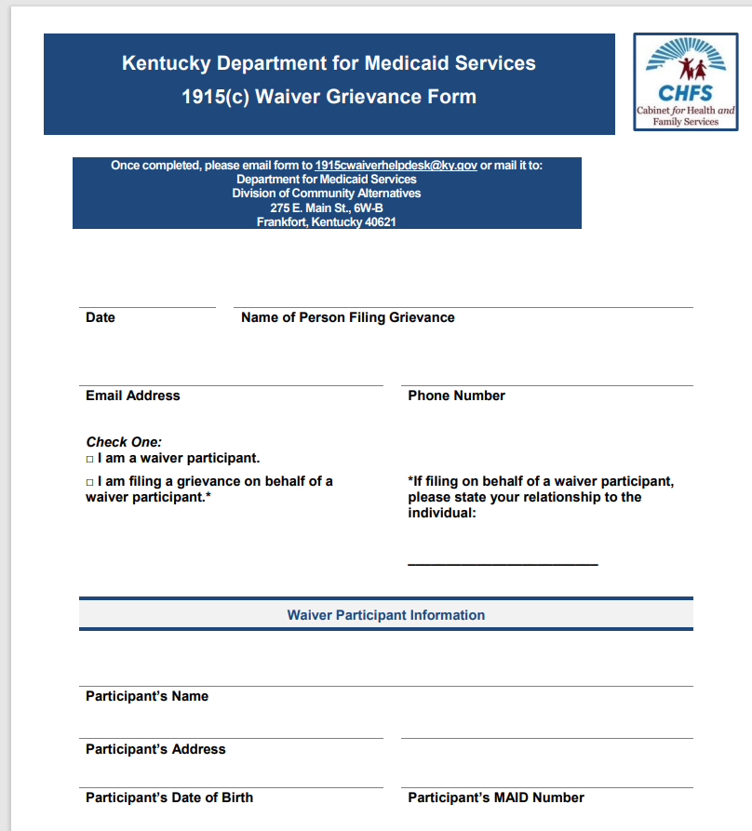
HOW TO FILE A GRIEVANCE OR COMPLAINT
To submit electronically, email a copy to: 1915cwaiverhelpdesk@ky.gov
To submit by mail, send the completed form to:
Department for Medicaid Services Division of Long-Term Services & Supports
275 E. Main St., 6W-B
Frankfort, Kentucky 40621
Each agency should have a complaint process in their policies & procedures
Case managers educate participants on complaint process
1915cgrievanceform.pdf (ky.gov)

Slide 27
PDS Financial Management
Financial Management Function
Memorandum of Understanding
PDS Employment Packets
Use of Employee Eligibility Form

Slide 28
Memorandum of Understanding (MOU)
The Case Management Agency and the Financial Management Agency enter into a Memorandum of Understanding and agree to work together to provide specific services to participants.
The MOU identifies key objectives and goals for service delivery.

Slide 29
DOCUMENTATION
SECTION III
29

Slide 30
PDS Specific Documents
Required for Each PDS Participant:
MAP-2000
PDS Employer Responsibilities & Expectations (ERE) Form
Participant Directed Services (PDS) Employee/Provider Contract
Employee Eligibility Form (EEF)

Slide 31
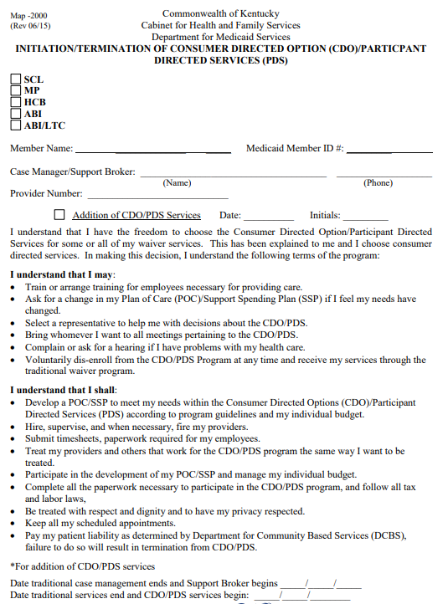
MAP-2000
Why is it Important?
Initiate & Terminate PDS Services
Designate a Representative
Document Voluntary Terminations & Reason for Involuntary Terminations

Slide 32
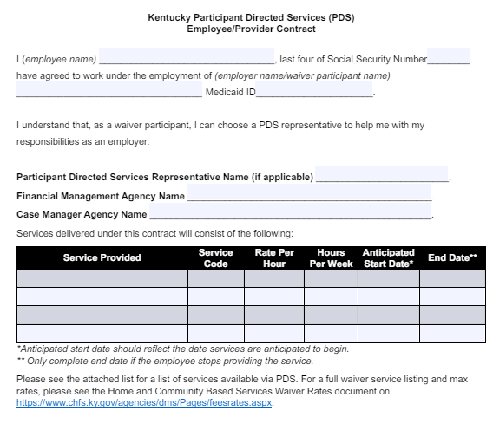
Kentucky Participant Directed Services (PDS) Employee/Provider Contract
Required for Each PDS Employee
Services & Rates Must Match PCSP
Must be Signed & Dated by Employee
Must be Signed & Dated by Employer (Participant or Rep.)
Employee-Provider Contract.pdf (ky.gov)

Slide 33
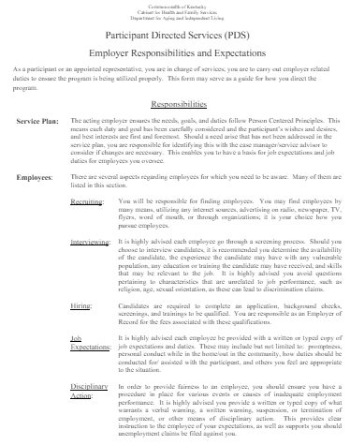
PDS Employer Responsibilities & Expectations (ERE)
Participants or Designated Reps. are Employers of Record
Form that Outlines the Responsibilities of PDS Employers (Participant or Rep.)
Required Annually at LOC Recertification
Required for Any Change in Rep.
https://www.chfs.ky.gov/agencies/dail/Documents/PDSEmployerResponsibilitie.pdf

Slide 34
MWMA Documentation
Guardianship
PDS Provider Contracts
What to Upload
Verification of Required Trainings
PDS Employment CPR First Aid Acknowledgement*
✓
* https://www.chfs.ky.gov/agencies/dms/dca/waivers/PDSacknowledgementCPR.pdf

Slide 35
MWMA Documentation
Employee Personally Identifiable Information (PII)
Do not Upload!
Drug Test Results & TB Risk Assessments
Criminal Background & Registry Results (AOC, NAR, CRC, & CMR or KARES)
Driver’s License
Automobile Liability Insurance Information
X

Slide 36
PDS EMPLOYMENT
SECTION IV

Slide 37
PDS employee requirements
Selected by Participant
Age (18 or Older)
Citizen of the US or Possess Valid Work Permit
Communicate Effectively
Understand and Carry-Out Instructions
Maintain Records
Submit to Background Requirements
No Disqualifying Background Check Findings
Complete All Required Trainings and Assessments

Slide 38
PDS Employee Packets
Federal I-9 Employment Eligibility Verification
Federal Tax Form W-4
KY Tax Form K-4
Background & Registry Check Resources
PDS Provider Contract(s)
DAIL Fraud, Waste & Abuse Training & Verification

Slide 39
PDS Background Checks
Completed prior to providing services
Out-of-State (O-O-S) Background Checks
May Use KARES vs. Separate KY & Other state Checks
No Other Background Check Services May be Used

Slide 40
PDS Background Checks
Not Be Convicted of:
A sex crime or violent crime under KRS Chapter 17
A prior felony conviction
A misdemeanor, felony plea bargain or amended plea bargain drug conviction during the previous 5 years
Abuse, neglect or exploitation (ANE)
No substantiation for ANE by CPS or APS
No Substantiation for Medicaid or Medicare Fraud by the OAG or OIG
No DUIs during Prior 12 Months or Cannot Transport

Slide 41
LEGALLY RESPONSIBLE INDIVIDUALS
SECTION V

Slide 42
Legally Responsible Individuals (LRI)
Parents, Step-parents, Adoptive Parents, or a Court-appointed Legal Guardians of Minor Child(ren) (Younger than 18); or
Spouses or Court Appointed Legal Guardians of Adult(s) (Age 18 and Older)
LRIs Must Provide “Extraordinary Care”

Slide 43
LRI Review Process
Participants and Employees Provide Information
Case Managers Enter LRI Information into MWMA
Attestation Form Must be Completed
DAIL Reviews Exemption Requests

Slide 44
Resources
PDS Forms Link Participant Directed Services - Cabinet for Health and Family Services (ky.gov)
Electronic Visit Verification https://www.chfs.ky.gov/agencies/dms/dca/Pages/evv.aspx
Toll-Free HCB2 PDS Hotline 877-315-0589
DAIL HCB2 PDS Inbox HCBinquiries@ky.gov

Slide 45
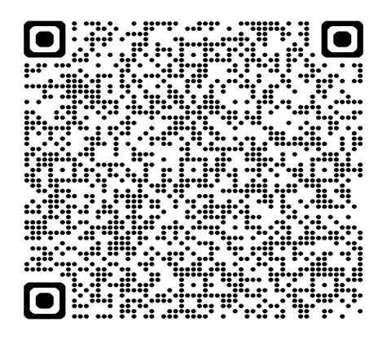
Please send any follow-up questions regarding this presentation or about HCB2 PDS to the HCBinquiries@ky.gov inbox.
Thank you!

